Slide 1
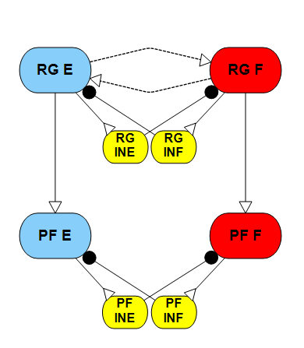
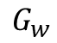


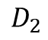

Aim 2:
Step 1
RG frequency control
Determine how Gw and drives/feedback influence the rhythm generation of the RG component.
Step 2
RG phase response curve
Investigate the influence of the Gw on the phase response to perturbations.
Step 3
Phase shift between the two layers of CPG
Quantify the phase shifts between the two layers of CPG caused by different stimulus/feedback.
$$D_{1}$$
$$G_{w}$$
$$G_{c}$$
$$G_{c}$$
$$D_{2}$$

Slide 2
Aim 2:
RG frequency control
2.09
4.372
6.0152
If we want a desired frequency of 1.1136 Hz, there are infinite solutions found by varying Gw and D1 Stimulus.
For example, possible solutions are [Gw D1] = [0 6.0152]; [0.1 4.372]; [0.3 2.09]; [0.59 0]. However, the performance for different conductances is not the same, as shown on the right.

Slide 3
Aim 2:
RG phase response curve
The perturbation response when an excitation stimulus of 5 nA injected into the extensor neuron during 0.3-0.5 of the normalized phase duration.
Top column:
Extensor neuron activities for unperturbed situation
Flexor neuron activities for unperturbed situation
Extensor neuron activities for perturbed situation
Flexor neuron activities for perturbed situation
Bottom column:
Neuron actives for the extensor neurons in the phase plane.
D = 6.0152; Gw= 0
D=0; Gw=0.59
The stimulus prolonged the active phase of extensor neuron for both cases. It shifts the phase for pure drive case by 10% and self-oscillation case by 7%.

Slide 4
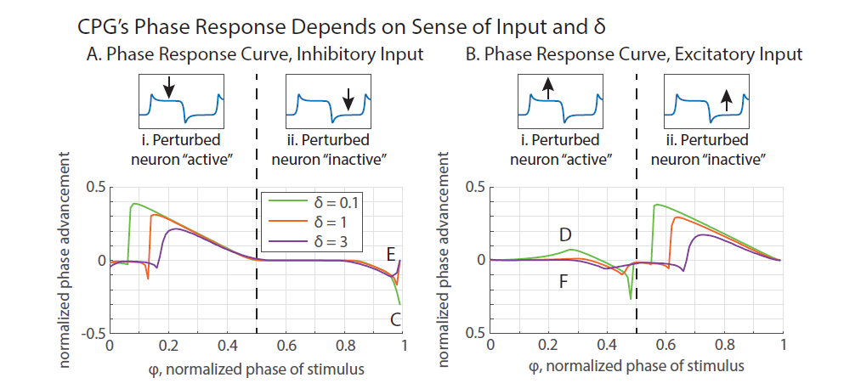
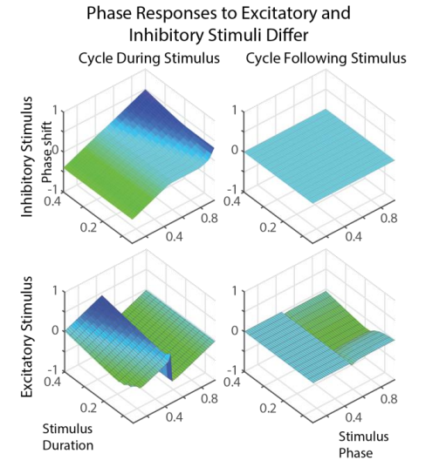
Aim 2:
RG phase response curve
(Szczecinski et al., 2017)
By setting Gw as zero, reproduce the results as shown in the figures using parameter values in reference.
Keep Gw as zero, produce the phase response curve using rat’s neural parameters.
Raise the Gw value so that it oscillates at the same frequency with no external inputs, producing the phase response curve.
(Szczecinski, Hunt, & Quinn, 2015)

Slide 5
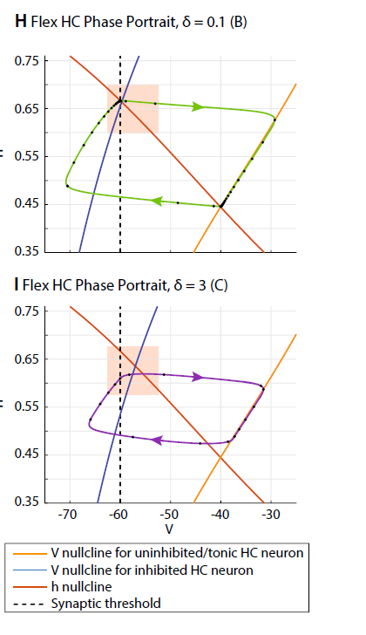

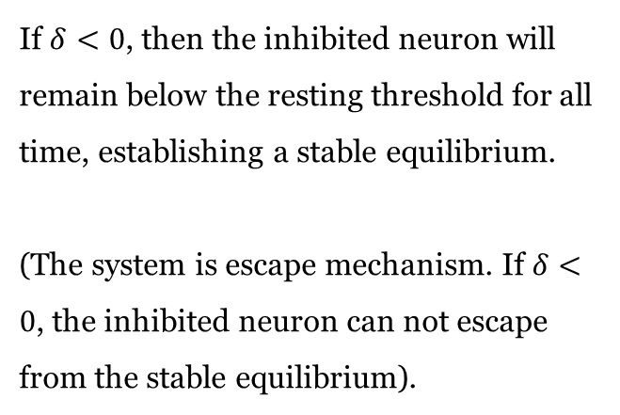

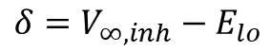
What is $δ$?
The strength of the synaptic inhibition establishes the difference between the inhibited neuron’s resting potential $V_{∞,inh}$, and the synaptic threshold $E_{lo}$, which we define as $δ$:
$$δ=V_{∞,inh}−E_{lo}$$
If $δ<0$, then the inhibited neuron will remain below the resting threshold for all time, establishing a stable equilibrium.
(The system is escape mechanism. If $δ<0$, the inhibited neuron can not escape from the stable equilibrium).
Gw = 0; increasing the drive
h - nullcline
Threshold
D = 0
D = 2
D = 4
D = 6

Slide 6

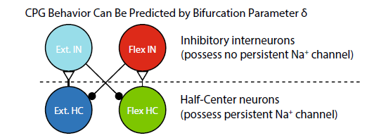
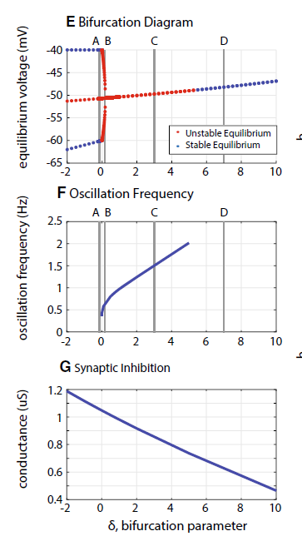
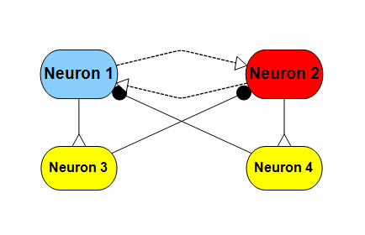
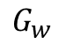
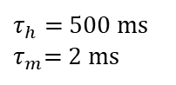
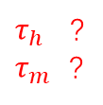
Interneurons: C_{m} = 5 nF, G_{m} = 1 uS, G_{Na} = 0 uS ,E_{r} = -60 mV.
HC Neurons: C_{m} = 5 nF, G_{m} = 1 uS, G_{Na} = 1 uS, E_{Na} = 50 mV,
A_{h} = 0.5, S_{h} = -0.046, E_{h} = -60 mV,
A_{m} = 1, S_{m} = 0.046, E_{m} = - 40 mV.
$τ_{h}$ ?
$τ_{m}$ ?
HC→IN: g_{Syn} = 0.118 uS, E_{s} = 300 mV.
E_{lo} = -60 mV, E_{hi} = - 20 mV.
IN→HC: g_{Syn} = 1.041 uS, E_{s} = -100 mV.
E_{lo} = -60 mV, E_{hi} = - 20 mV.
$τ_{h}$ = 500 ms
$τ_{m}$= 2 ms
$$G_{w}$$

Slide 8
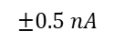
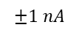
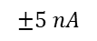
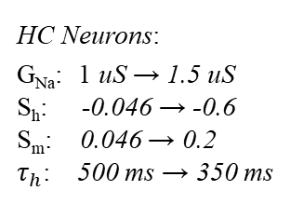
Keep Gw as zero, produce the phase response curve using rat’s neural parameters. (No external drive)
HC Neurons:
G_{Na}: 1 uS → 1.5 uS
S_{h}: -0.046 → -0.6
S_{m}: 0.046 → 0.2
$τ_{h}$: 500 ms → 350 ms
Synapse:
E_{hi}: -20 mV → -40 mV
$$±5 nA$$
$$±1 nA$$
$$±0.5 nA$$
Notes:
HC determine the voltage range.

Slide 9
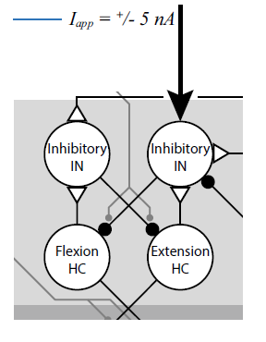
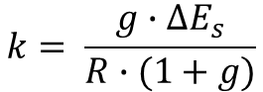
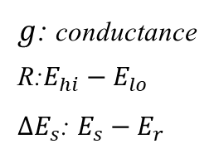
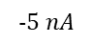
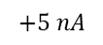
$g$: conductance
R:$E_{hi}−E_{lo}$
$∆E_{s}$: $E_{s}−E_{r}$
$$k= \frac{g∙∆E_{s}}{R∙(1+g)}$$
HC→IN:
k ratio (2.43 ~ 3.74)
IN→HC:
(1.62 ~ 1.76)
$$+5 nA$$
$$−5 nA$$

Slide 10
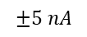
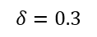
When change from insect to rat, we change both sodium channel and the synapse parameter, what is their effects?
Change synapse
Change HC
$$δ=0.3$$
f
$$±5 nA$$

Slide 11
Keep Gw as zero, produce the phase response curve using rat’s neural parameters. (external drive involved)
External drive = 6 nA, tuning the synaptic inhabitation
Conductance g_{Syn} = 2 uS, tuning the external drive
Solid line no drive
Dash line D = 6, tuning G
Dot line G = 2, tuning D

Slide 12
Keep Gw as zero, produce the phase response curve using rat’s neural parameters.

Slide 13
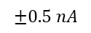
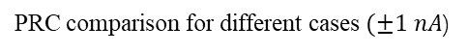
Raise the Gw value, producing the phase response curve. (No drive)
$$±0.5 nA$$
PRC comparison for different cases $(±1 nA$)
Frequency comparison for different cases
Gw = 0, no external drive
Gw increase, no external drive
Gw = 0, increase external drive
Gw = 0, external drive, reduce G

Slide 14
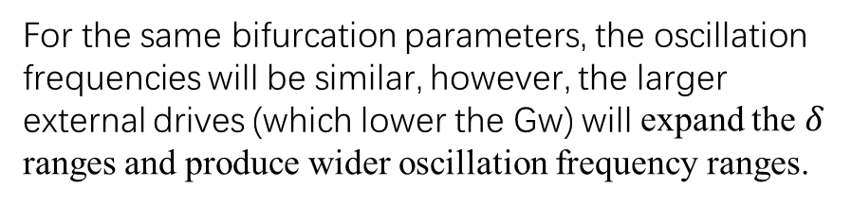
Raise the Gw value, given a external drive.
For larger given drives, a lower Gw is needed to achieve the same bifurcation parameter.
For the same bifurcation parameters, the oscillation frequencies will be similar, however, the larger external drives (which lower the Gw) will expand the $δ$ ranges and produce wider oscillation frequency ranges.

Slide 15
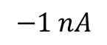
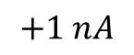
Raise the Gw value, given a external drive.
D = 0
D = 2
D = 4
$$−1 nA$$
$$+1 nA$$

Slide 16
Gw = 0.1, tuning drive for delta

Slide 17
Gw = 0.1, tuning drive for delta
D=0 tuning Gw
D=2 tuning Gw
D=4 tuning Gw
Gw=0.1 tuning D

